Slide 1



User-Customized Restaurant Recommendation using NLP on OUR Customized Yelp Dataset
Spring 2020: CSE6240: Web search and Data Mining
Somdut Roy Vitaly Marin Devanshee Shah
slide version 3.2

Slide 2
Motivation/Introduction
Problem Description: You want to get a recommender system to provide a feedback where best to eat (at which restaurant) that you have not been before provided your favorite restaurant only and restaurant user review/ratings. This presents a challenging problem.
Problem Importance: user recommender systems exist; however those have not been applied to our customized restaurant dataset with user ratings and <todo add here more>

Slide 3
Methodology: Baseline Approaches/Algorithms
What are our baseline Approaches ?
Baseline Approach #1: SVM on vector data
Baseline Approach #2: Logistic Regression on vector data
Description of how each baseline approach work (baseline 1) (todo: add here)
Description of how each baseline approach work (baseline 2) (todo: add here)

Slide 4
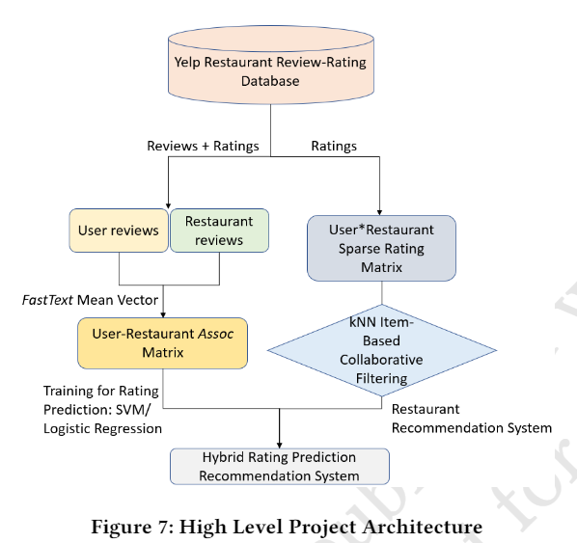
Our Approach/Algorithms Description
Our approach combines user restaurant ratings prediction based on Linear SVM (Baseline 1), Logistic Regression (Baseline 2) and item based collaborative filtering technique to create a hybrid ratings that can be used to sort the relevant restaurants for a specific user that user given only user’s preference for specific restaurant.
TODO: need to update slide Somdut will give powerpoint slide
Our model is summarized in the diagram →

Slide 5
User-Restaurant Assoc Matrix details

Slide 6
KNN – Item based Collaborative filtering
Todo: Devanshee.

Slide 7
Our Approach/Algorithms Novelty
The Novelty of our approach is to create the hybrid ratings by combining rating prediction for restaurants and Item based collaborative filtering to restaurant dataset together.
Created the Associative Matrix and used the FastText.

Slide 8
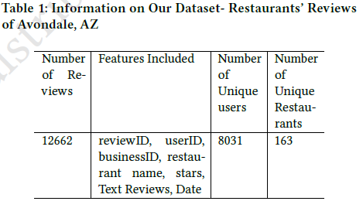
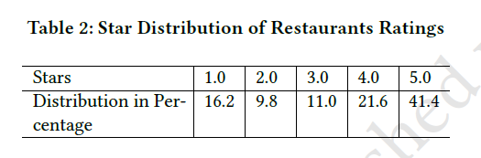
Our Dataset: Filtered Yelp Dataset. Finalized
Description of dataset and its useful features and our dataset was constructed using Yelp dataset using Avondale, AZ city.

Slide 9
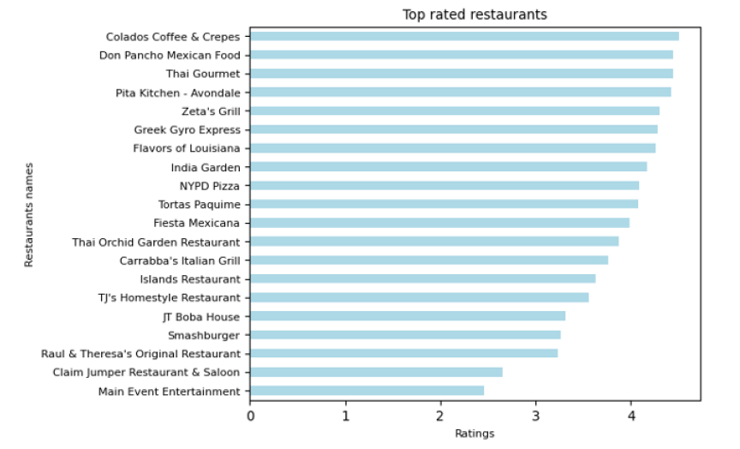
Our Dataset: customized Yelp Dataset. Finalized Cont. Features/Details

Slide 10
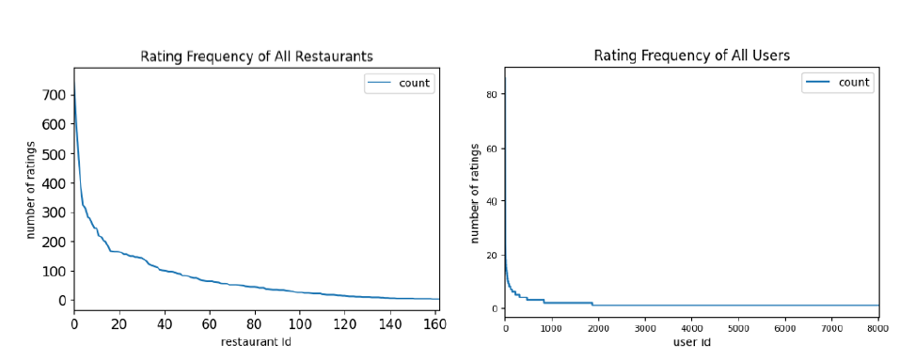
Our Dataset: Rating Frequency of Restaurants’ and User Frequency of all users

Slide 11
Experiments and Evaluations
Description of the experimentation setup .
We used Google collab to run our experiments.
Description of evaluation criteria for the experiment: (accuracy of the predicted ratings )
(todo add more here)

Slide 12
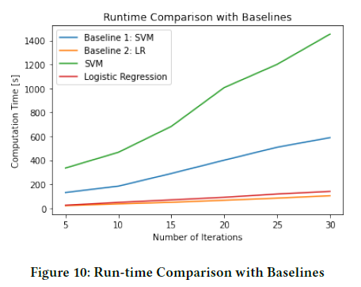
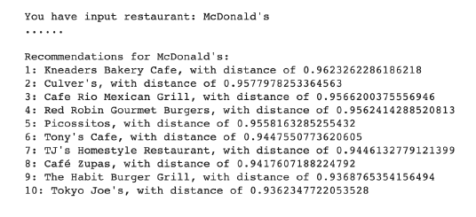
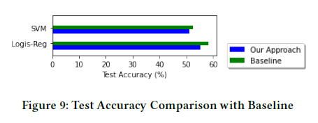
Our Results
<todo add info on results>.

Slide 13
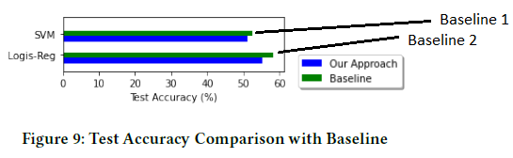
Our Results and Comparison to Baseline Results.
TODO: Add Metric used here.

Slide 14
Conclusion
Method | Accuracy | Time Compcomplexity
Baseline 1 SVM without Matrix (what paper ?) |  | Somdut will provide the numbers on this
Our Approach with Matrix SVM |  | Somdut will provide the numbers on this
Our Approach Logistic Regression with Matrix |  | Somdut will provide the numbers on this
Our Approach Logistic Regression without Matrix |  | Somdut will provide the numbers on this
Baseline 2 Logistic Regression without Matrix |  | Somdut will provide the numbers on this
Our Approach with Matrix SVM
Our Approach Logistic Regression with Matrix
Summary of effort. Add summary table here of results.

Slide 15
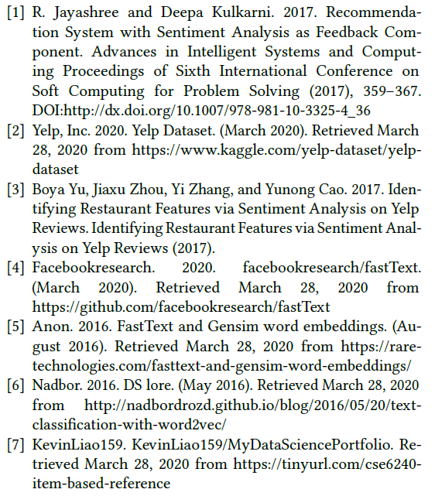
References:

Slide 16
Future Work
We will use the reviews for the item based collaborative filtering in the future work to benchmark it against our other two approaches.

Slide 17
Delete: Notes to self.
Types of predictions:
Combined system: User A ( no needed rated restaurant G), Given favorite restaurant Z what is next great restaurant X to go to ?( combined system) with right side and left side.
Left side of the diagram: User A ( rated restaurants several restaurants), what is the rating of any restaurant that the user has not been to.
What is really needed ? (did the user really need to rate anything ?)
User A provided what his/her favorite restaurant is.
Does the favorite restaurant Z need any ratings ?
Does the recommended restaurant X need any ratings ?

